Slide 1

FEATURE SALES PREDICTION

Slide 2
INTRODUCTION:-
In this paper we present detailed description and evaluation of the Kaggle future sales prediction challenge. The remaining of the paper is oriented as follows: In Section 2 and 3, we present details of data pre-processing. Section 4 elaborates about feature engineering to generate the trainable parameters. Section 5 describes the model description of the tree based models which were used. We present detailed results in Section 6 before concluding in Section 7.

Slide 3
2.DATA PRESENTATION:-
Training data given in train.csv has 2935849 rows and has 6 columns: date, date_block_num, shop_id, item_id, item_price, item_cnt_day. The date range is from 1st January, 2013 to October 2015. The month number is listed from 0 to 33 in date_block_num. Each row is associated with a per day sale of a specific item along with its shop id. The per day sale of each item in a shop wise mannner (per shop id wise) is listed under item_cnt_day. Shop information is provided for 60 shops in the form of shop name and shop id in shops.csv. Details about items are provided in items.csv regarding item_id, item_name and item_category_id. There are total 22170 items. Further details about the item categories are provided in item_categories.csv in the form of item_category_name and item_category_id. The goal is to predict the monthly sales for each item-shop id pair in test set.

Slide 4
3.DATA-PREPROCESSING:-
Training data given in train.csv has 2935849 rows and has 6 columns: date, date_block_num, shop_id, item_id, item_price, item_cnt_day. The date range is from 1st January, 2013 to October 2015. The month number is listed from 0 to 33 in date_block_num. Eac23h row is associated with a per day sale of a specific item along with its shop id. The per day sale of each item in a shop wise mannner (per shop id wise) is listed under item_cnt_day. Shop information is provided for 60 shops in the form of shop name and shop id in shops.csv. Details about items are provided in items.csv regarding item_id, item_name and item_category_id. There are total 22170 items. Further details about the item categories are provided in item_categories.csv in the form of item_category_name and item_category_id. The goal is to predict the monthly sales for each item-shop id pair in test set.

Slide 5
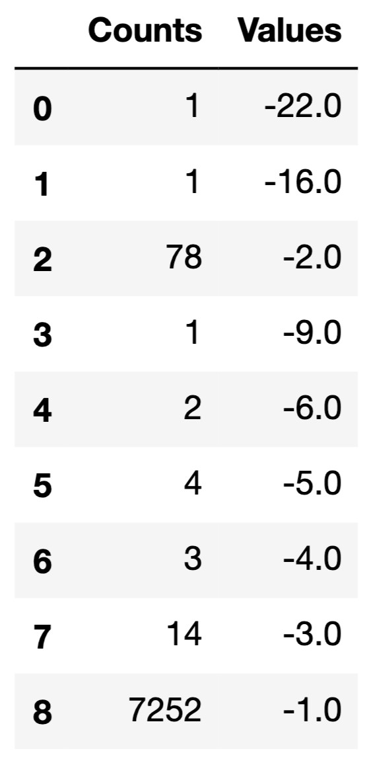
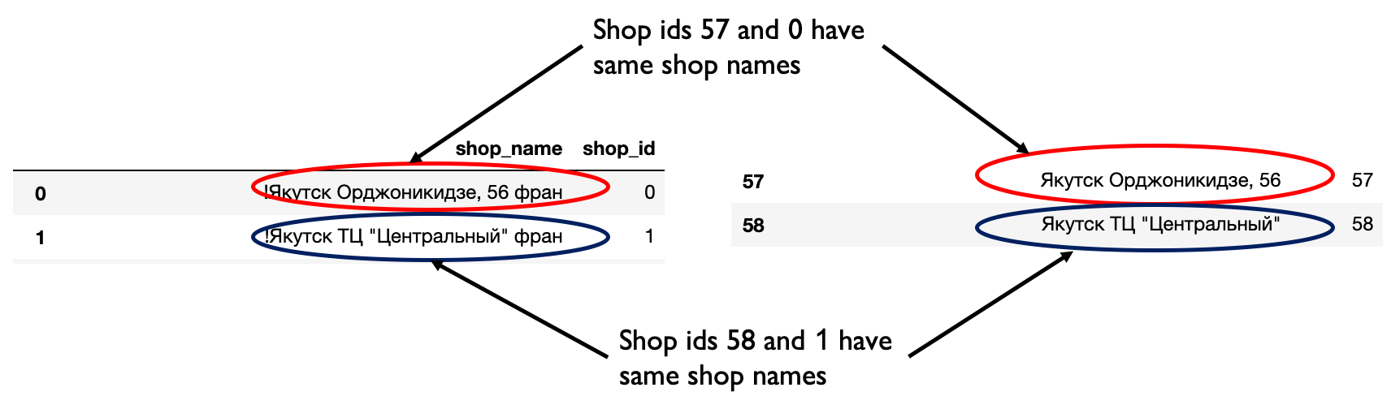
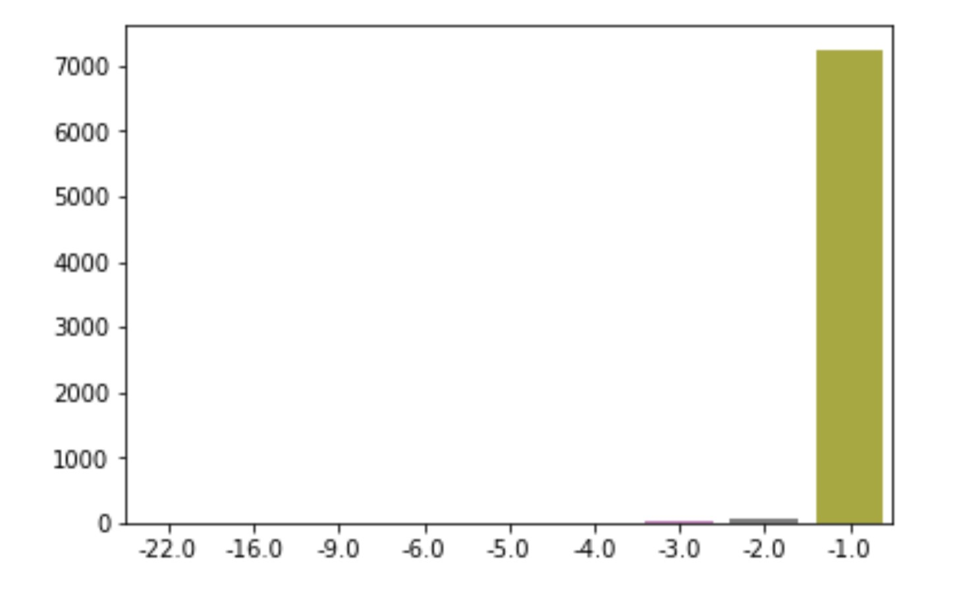
From the given shop data information in shops.csv, we have details of 60 shops with their shop names and ids. From the shop name information, we can see that there are multiple cases where shops with
Figure 1: (a) Example of same shop names for different shop ids, (b) Distribution and (c) per element count of negative values of feature item_cnt_day

Slide 6
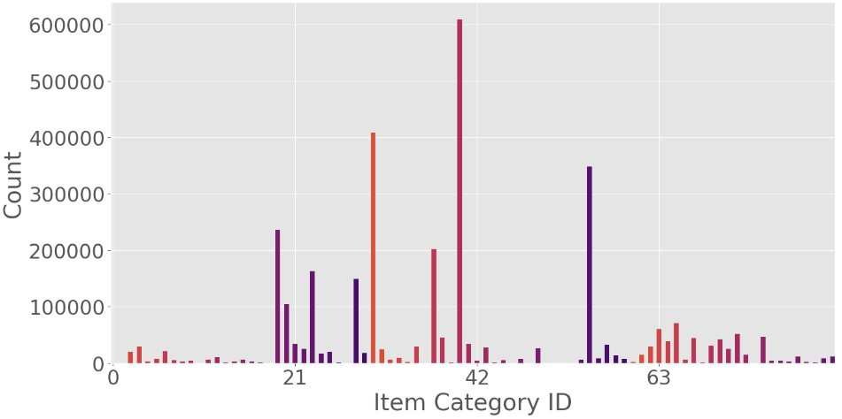
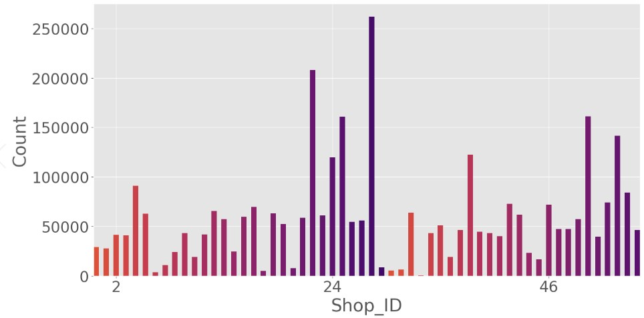
4 .FEATURE ENGINEERING
4.1 DATA EXPLORATION
In order to find the distribution of data across different shops and item categories, we plot the monthly item count with different item category ids (84 in total) and shop ids (60 in total). The monthly count distributions are shown in Fig 2(a) and Fig 2(b), respectively.

Slide 7
Above figures Represents:- (a) Distribution of monthly count with item category id. 84 item categories are listed in x axis. (b) Distribution of monthly item count with shop id. 60 shop ids are listed in x axis.
4.2 ITEM CATEGORY AND NAME BASED FEATURES
We also extract features related to item name from the item_name field in items.csv. We split the item_name using two delimiters "[" and "(" into fields name2 and name3 respectively. We further extract the item type information from name2 section. We then find the count of each item type from 22170 item ids available in items.csv. Using the item type information, we group those entries in name2 together whose counts are less than 40.

Slide 8
4.3 SHOP BASED FEATURES;-
To extract shop based features, we use the information given in shops.csv. Each entry in shop_name column is split into shop_category and shop_name. We split the shop_name based on " " delimiter and use the first split string as city and the subsequent one as the shop category. We broadly group the shop categories into 5 segments based on number of occurrences. The distribution of shop categories are listed in Fig 3a. In Fig 3b, the category names are listed in Russian.

Slide 9
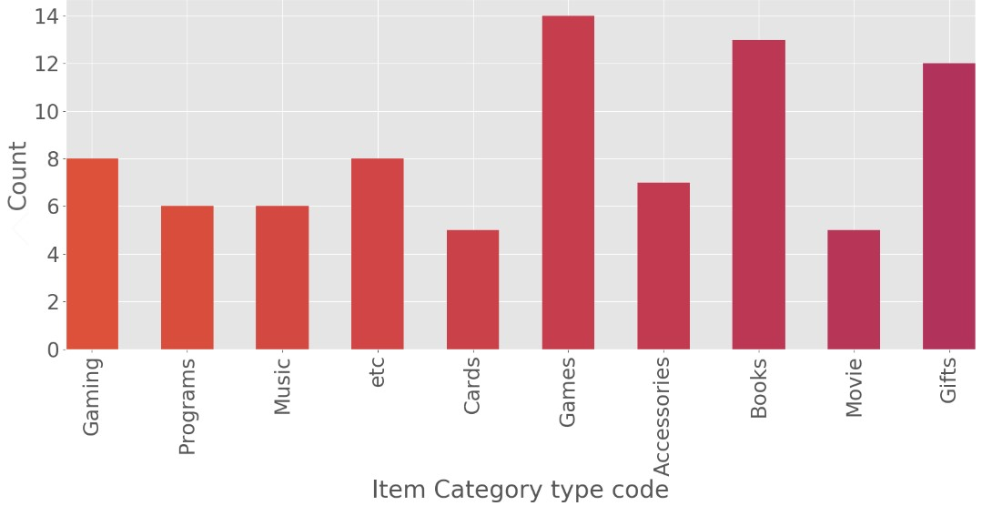
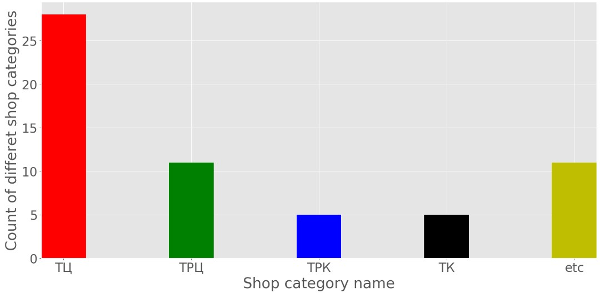
(a) Distribution of type codes of various 84 item categories. The type codes are translated from Russian to English. (b) Distribution of shop categories among the 60 shops listed in shops.csv. Shop category names are listed in Russian

Slide 10
4.4 MEAN ENCODED FEATURES AND LAG FEATURE GENERATION
For generating the training data, we first consider each valid shop id-item id pair for each month. This is done to make the training data similar to the testing data where predictions have to be done for each shop-item id pair. In the above shop id-item id based training data, we add average statistics for various combinations
. For each month, we first extract the average item count as date_avg_item_cnt. We extract the average monthly item count features based on item id (date_item_avg_item_cnt), shop id (date_shop_avg_item_cnt), shop id and item id pair(date_shop_item_avg_item_cnt), shop id and subtype code (date_shop_subtype_avg_item_cnt), shop city(date_city_avg_item_cnt) and shop city and item id pair(date_item_city_avg_item_cnt).
The features from previous time steps are included as lag_i(feature from ith previous month, i=1,2,3).

Slide 11
5. MODEL SELECTION
This section describes the models which we have used for our future sales prediction. In particular, we have successfully used three decision tree based models namely, XGBoost, random forest, and light GBM to get competitive performance.
5.1 XGBoost
XGBoost [1] stands for extreme Gradient Boosting. It is an open source library providing a highperformance implementation of gradient boosted decision trees (GBDT).
The implementation of the algorithm was engineered for efficiency of compute time and memory resources
(a) Sparsity Aware implementation with automatic handling of missing data values.
(b) block Structure to support the parallelization of tree construction. To learn the set of functions used in the model, XGBoost minimizes the following regularized objective

Slide 12
5.2 random forest
The random forest is a model made up of many decision trees. Rather than just simply averaging the prediction of trees (which we could call a “forest”), this model uses two key concepts that gives it the name random, and are described next.
Random Sampling of Training Observations When training, each tree in a random forest learns from a random sample of the data points.
The samples are drawn with replacement, known as bootstrapping, which means that some samples will be used multiple times in a single tree.
Overall, the entire forest will have lower variance but not at the cost of increasing the bias.At test time, predictions are made by averaging the predictions of each decision tree.

Slide 13
5.3 light gbd
Every feature,conventional implementations of GBDT scan all the data instance to estimate the information gain of all the possible split points
Therefore, their computational complexities will be proportional to both the number of features and the number of instances. This makes these implementations very time consuming when handling big data.
. To tackle this issue Light GBM (LGBM) [2] uses two novel techniques, namely Gradient-based One-Side Sampling (GOSS) and Exclusive Feature Bundling (EFB).

Slide 14
conclusion
In this work we presented future sales prediction models based on decision tree structures. Our evaluation showed the best performing model can be achieved through ensembling of LGBM and random-forest giving equal weight to each

